Slide 1
Next level RPA Modularized ML with post go-live RPA finance process
Trung Nguyen

Slide 2

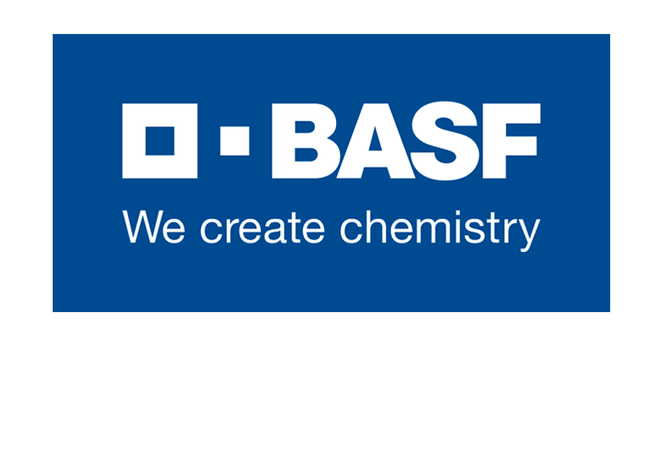


About Me
2015
2018
2019
Big Data Analyst
RPA Data Scientist
Data Scientist

Slide 3
Agenda
Workshop case introduction
Enterprise technology adoption maturity
Pillars of design in 4.0 era
Interactive live demo
Background on RPA & ML

Slide 4

Background on RPA & ML

Slide 5
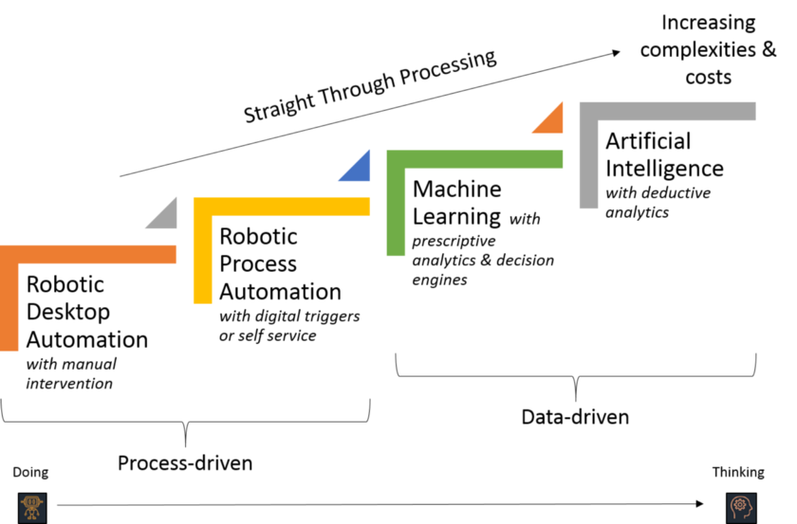

Slide 6
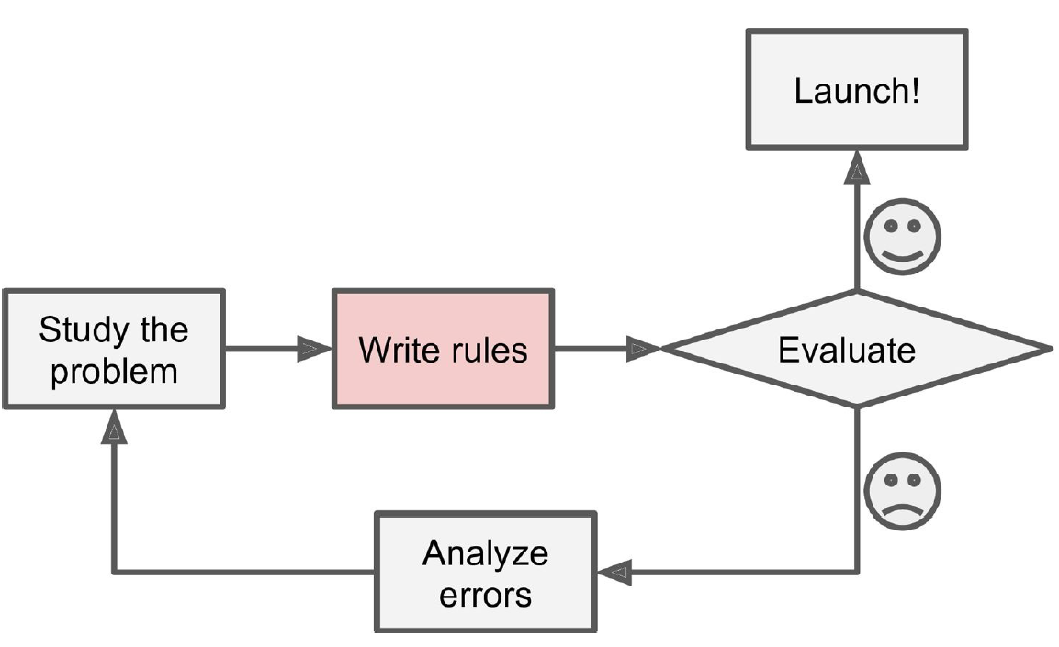
Robotic Process Automation’s approach
RPA’s approach

Slide 7
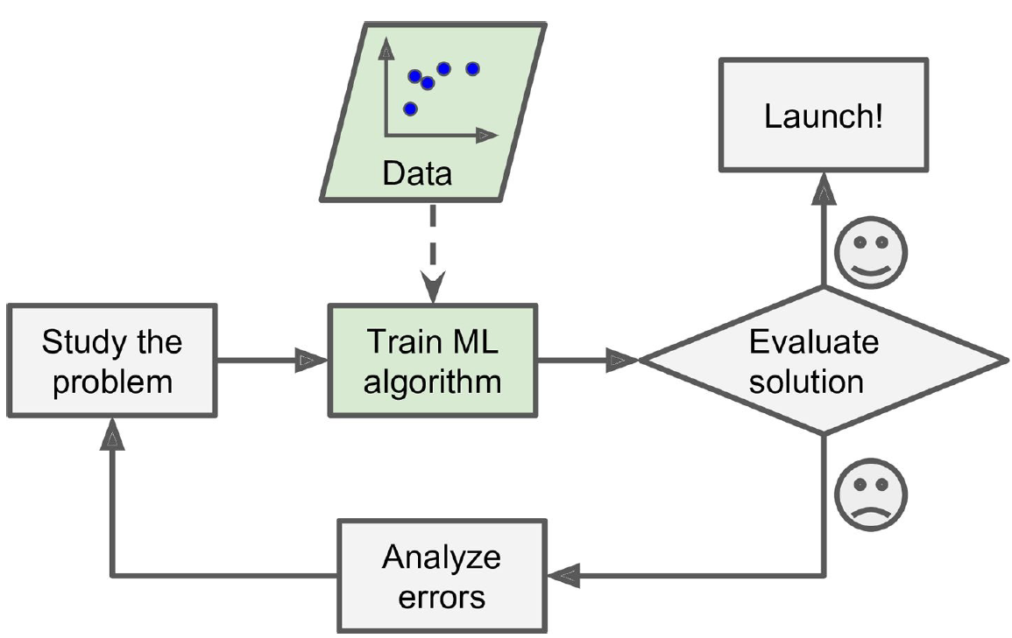
Machine Learning’s approach
ML’s approach

Slide 8

Case introduction

Slide 9
Case background
Large drug stores chain
Forecasting sales reports on a frequent basis
RPA teams with strong IT infrastructure
Data analysts/scientists available

Slide 10










Sales forecasting reports for multiple departments on a weekly basis
In-house database
Client’s departments
Communication channels
Data warehouse
Create reports
Board members
Generate forecasts
BI Dashboard
Historical data

Slide 11
Enterprise technology adoption maturity

Slide 12
High
Evolve from analytics deparment (sales & marketing) Support high-level decision making process across company | Gold standard for enterprises Strong linkage between RPA & ML ➔ Ecosystem
Still skeptical about the 2 technologies Might not have needs at the current moment | Catch “low-hanging fruits” with RPA in short-mid term Conservative and safe Most likely the route for “digitalization”
High ML
Low RPA
High ML
High RPA
ML capabilities
Low RPA
Low ML
High RPA
Low ML
RPA maturity
Low
High

Slide 13
Design in 4.0 era

Slide 14
STANDARDIZATION
Revenue forecasting reports for multiple departments on a weekly basis
MODULARIZATION
In-house database
Client’s departments
AUTOMATION
Communication channels
Data warehouse
Create reports
Board members
Generate forecasts
SCALABILITY
BI Dashboard
Historical data

Slide 15
Sales forecasting reports for multiple departments on a weekly basis
In-house database
Client’s departments
Communication channels
Data warehouse
Create reports
Board members
Generate forecasts
Human
BI Dashboard
Historical data
RPA Bot 1
RPA Bot 2

Slide 16
Live Demo

Slide 17
Live Demo
RPA
ML Programming Language
rpa.ai.usecase@gmail.com
UiPath (no Orchestrator)
R
Mail engine
Rshiny | QlikView
Rossmann Sales (Kaggle)
Timeline : 2013 – 2015
No. Stores : 1115
Datasets

Slide 18
Live Demo
Multiple RPA bots with human intervention
One RPA bot with ML module
Update ML module with new data and models
The task is to forecast sales for the next 1 month and send reports to clients

Slide 19
1. Multiple RPA bots with human intervention
Sales forecasting reports for multiple departments on a weekly basis
In-house database
Client’s departments
IT IS CURRENTLY 06.2014
Communication channels
Data warehouse
Create reports
Board members
Generate forecasts
Human
BI Dashboard
Historical data
RPA Bot 1
RPA Bot 2

Slide 20
1. Multiple RPA bots with human intervention
Sales forecasting reports for multiple departments on a weekly basis
In-house database
Client’s departments
Communication channels
Data warehouse
Create reports
Board members
Generate forecasts
Human
BI Dashboard
Historical data
RPA Bot 1
RPA Bot 2

Slide 21
2. One RPA bot with ML module
Sales forecasting reports for multiple departments on a weekly basis
In-house database
Client’s departments
Communication channels
Data warehouse
Create reports
Board members
Generate forecasts
ML module
BI Dashboard
Historical data
RPA Bot

Slide 22
3. Update ML module with new data and model
Sales forecasting reports for multiple departments on a weekly basis
In-house database
Client’s departments
IT IS CURRENTLY 01.2015
Communication channels
Data warehouse
Create reports
Board members
Generate forecasts
ML module
BI Dashboard
Historical data
RPA Bot

Slide 23
3. Update ML module with new data and model
Sales forecasting reports for multiple departments on a weekly basis
In-house database
Client’s departments
Communication channels
Data warehouse
Create reports
Board members
Generate forecasts
ML module
BI Dashboard
Historical data
RPA Bot

Slide 24

Thank You
Trung Nguyen

Slide 25
BACKUP
A. Give out revenue forecasting reports for multiple departments occasionally
In-house systems
Client’s departments
Communication channels
Consolidating database
Board members
Generating forecasts
Historical data
BI Dashboard
RPA 1
ML
RPA 2
1. SPA
2. Why RPA + ML
3. RPA 2.0
4. Use cases
5. Initiate RPA + ML

Slide 26
Smart Process Automation
BACKUP
Current RPA (non-ML)
Rule-based process - rules tell a computer how to response to different situations
No self-decision capability
Static
SPA (ML enhancement)
Adapt when exposed to new data
Reinforce learning to improve performance on narrowly defined tasks
Dynamic
Source: Working with ML & RPA - UiPath

Slide 27
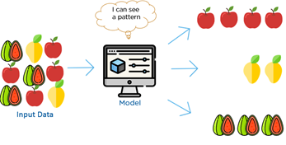
Machine Learning Techniques
BACKUP
 | Characteristics | Algorithm (examples) | Use cases
Unsupervised | Input data is unlabeled No need for training data Use for analysis | Clustering & Dimensionality reduction Association analysis Hidden Markov model | Ticket categorizations Market-basket analysis
Supervised | Input data is labeled Need training / testing data Use for prediction | Regression (linear + logistics) Decision trees Naïve Bayes Support vector machine | Sales forecasting Fraud detection Customer churn analysis

Slide 28
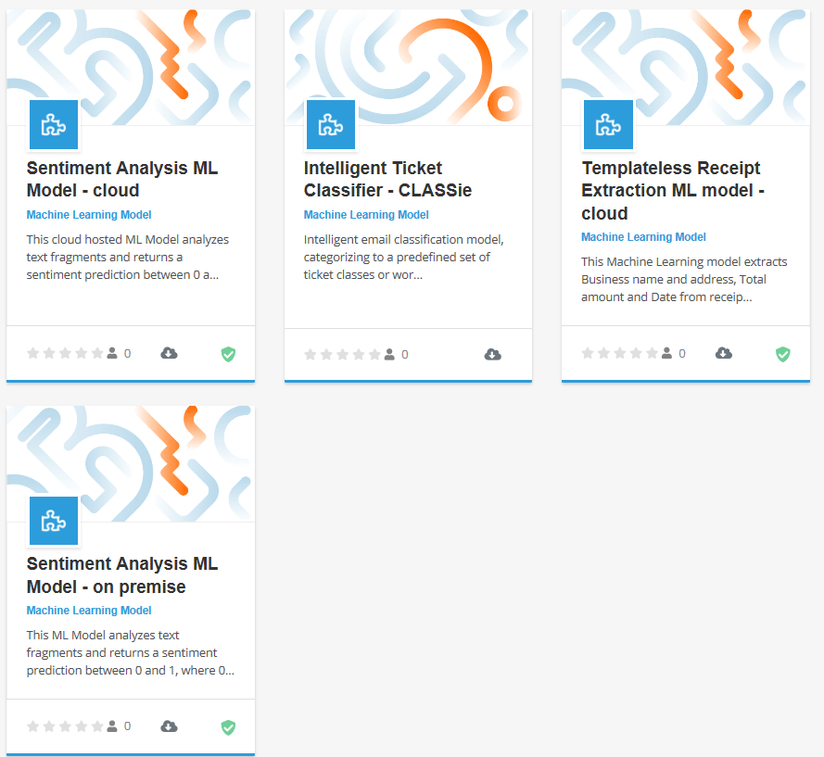
Current situation of UiPath on ML (1)
BACKUP
UiPath Go – Machine Learning components
Single-built common modules for universal purpose (Ex: sentiment analysis with lexicon)
➔ Can not solve specific cases with distinct requirements
1. SPA
2. Why RPA + ML
3. RPA 2.0
4. Use cases
5. Initiate RPA + ML

Slide 29
Current situation of UiPath on ML (2)
BACKUP
UiPath Go workflow
Common sentiment analysis workflow (ensemble modeling)
Get Text activities
Preprocessing
ML
Get Text activities
Step 1
Step 2
Step 3
….
ML
Sentiment lexicon scoring
Modeling
Model 1
Model 2
Model 3
….
Result [negative, positive, neutral]
Validating
Continue with RPA’s process
Continue with RPA’s process
Deployment
1. SPA
2. Why RPA + ML
3. RPA 2.0
4. Use cases
5. Initiate RPA + ML

Slide 30
Current situation of UiPath on ML (2)
BACKUP
UiPath Go workflow
Common sentiment analysis workflow (ensemble modeling)
Get Text activities
Get Text activities
Preprocessing
Stop-words removal
N-gram modeling
Word embedding
ML
Sentiment lexicon scoring
Abbreviation translation
Lemmatization
Tokenization
….
Modeling
Result [negative, positive, neutral]
Lexicon models
Supervised Learning
BingLiu
Build labeled dataset
Continue with RPA’s process
….
NRC
LR
SVM
NB
….
….
1. SPA
2. Why RPA + ML
3. RPA 2.0
4. Use cases
5. Initiate RPA + ML

Slide 31
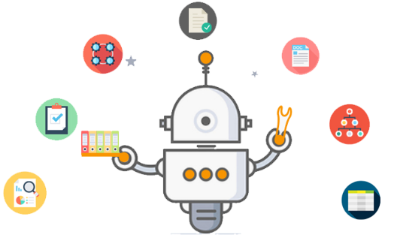
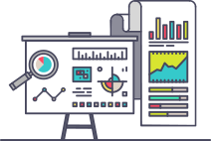


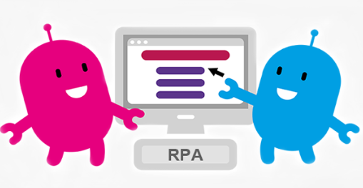
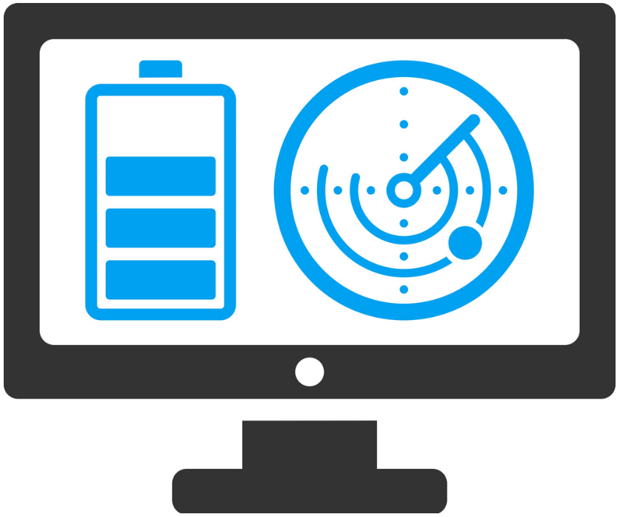

RPA + ML life cycle
BACKUP
Is this a ML problem?
YES
Analyze Data
Select, train and tune ML model
Green-light for RPA
NO
Integrate and apply to RPA
Operate, monitor and maintain model
Deploy and test models
1. SPA
2. Why RPA + ML
3. RPA 2.0
4. Use cases
5. Initiate RPA + ML

Slide 32





BACKUP
B. Summarize and classify documents then send feedback/reports
In-house systems
Summarize
Case’s owners
Communication channels
Consolidating database
Classify
Clients
Templates
Others
Sentiment analysis
BI Dashboard
RPA
ML
RPA

